Slide 1

IMDB_MOVIE ANALYSIS
BY:- HARSH WARDHAN SINGH

Slide 2
PROJECT DESCRIPTION:
The IMDb Movie Analysis project aims to explore and analyze a comprehensive dataset of movies available on the IMDb platform.
This dataset contains essential information about movies, including director names, movie titles, duration, genre, budget, gross earnings, IMDb ratings, and more.
Through in-depth data analysis using Excel, Data Visualization and Statistics techniques this project seeks to extract valuable insights and trends that contribute to a movie's success.

Slide 3
DATA HANDLING My Approach
I have gone through the dataset and understood all the given columns. Then I have observed that there are a total of 28 Columns and 5043 Rows. This dataset consists of unwanted columns, Null values and Blank rows. So, I have decided to Clean this dataset thoroughly.
First, I have deleted the columns which have no relation to our project and don't provide any valuable insights. In the end, I only left with 8 Columns which are director’s name, duration, movie title, genre, budget, gross, IMDB rating, language .
3) Then, I noticed that there were many blank rows. To find them I first clicked on “Find & Select” then clicked on “go to special” and selected the “blank” option. It highlighted all the blank rows. Then I clicked the shortcut “CTRL + - ” and selected the “Entire rows” option. This process deleted the entire blank rows in the dataset.

Slide 4
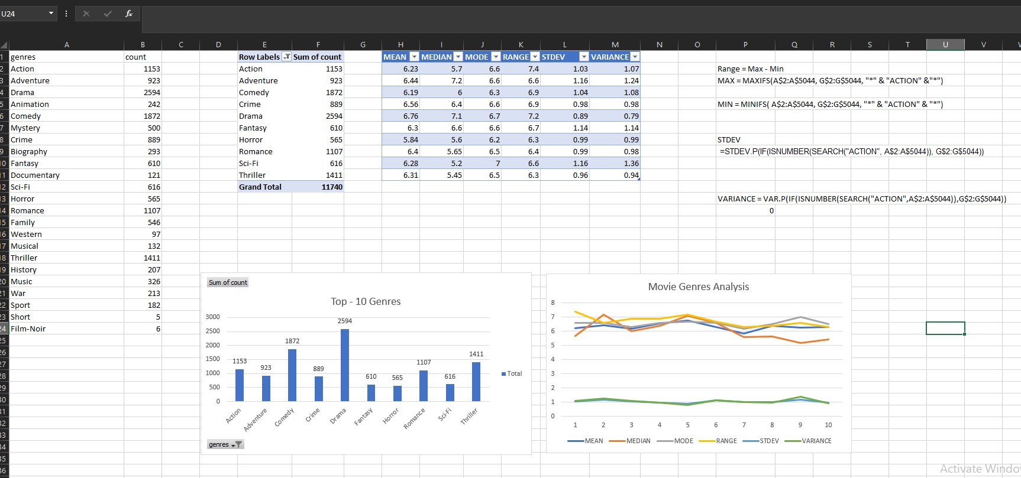
Movie genre analysis Analysee the distribution of movie genres and their impact on the IMDB score. Task: Determine the most common genres of movies in the dataset. Then, for each genre, calculate descriptive statistics (mean, median, mode, range, variance, standard deviation) of the IMDB scores

Slide 5
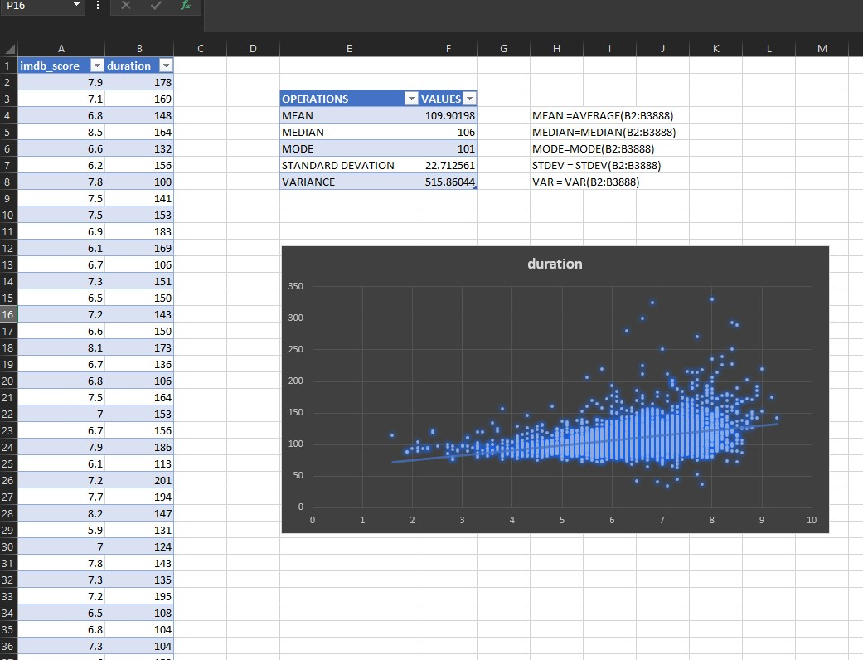
2. Movie duration analysis Analyze the distribution of movie durations and its impact on the IMDB score. Task: Analyze the distribution of movie durations and identify the relationship between movie duration and IMDB score.

Slide 6
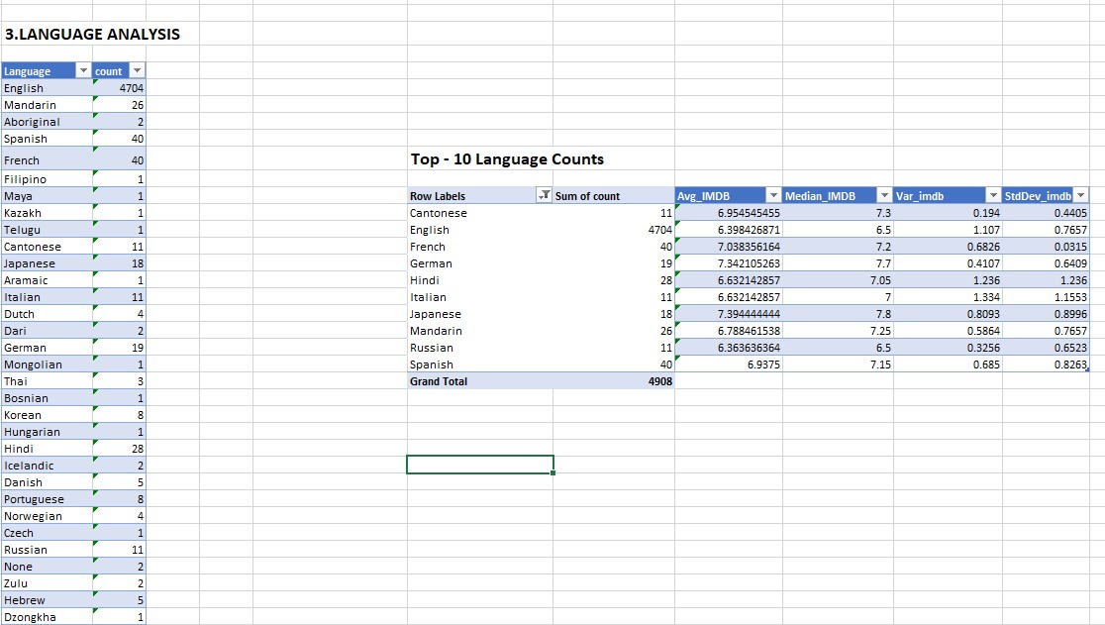
3.Movie language analysis Situation: Examine the distribution of movies based on their language. Task: Determine the most common languages used in movies and analyse their impact on the IMDB score using descriptive statistics.

Slide 7
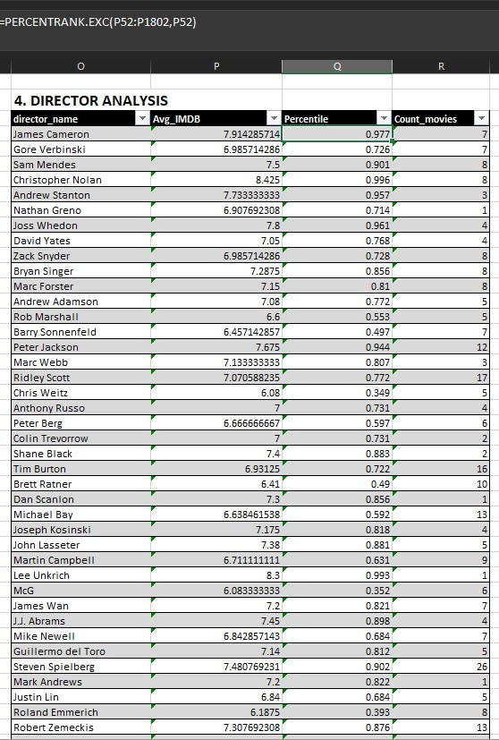
4. Movie director analysis
Influence of directors on movie ratings.
Task: Identify the top directors based on their average IMDB score and analyse
their contribution to the success of movies using percentile calculations.

Slide 8
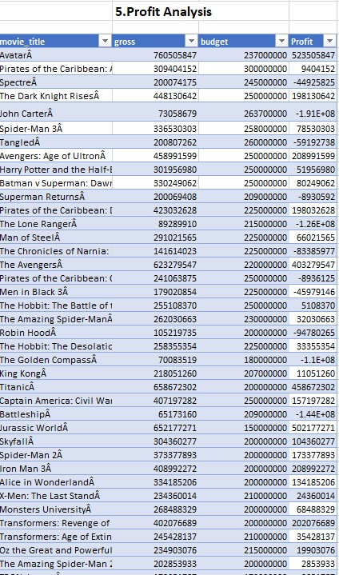
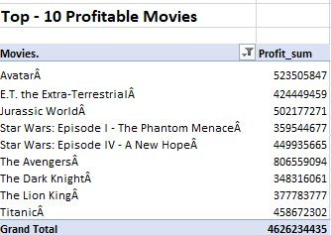
5. Movie budget analysis. Explore the relationship between movie budgets and their financial success. Task: Analyze the correlation between movie budgets and gross earnings, and identify the movies with the highest profit margin.

Slide 9
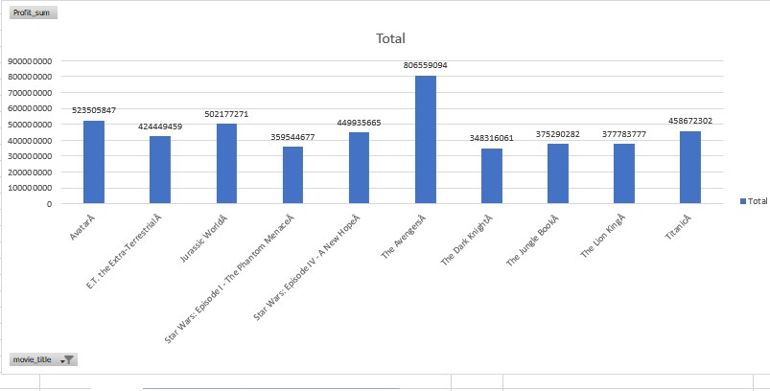
5. Movie budget analysis

Slide 10
Thank you !!

